Slide 1

Presenting EVA B2: A Complete and Innovative Conversational Assistant for the UPF Community
DEPARTMENT OF INFORMATION AND
COMMUNICATION TECHNOLOGIES
NLI PRESENTATION
20 MARCH, 2023
DONGJUN TANG, GUILLEM MORENO,
IGOR KUZMIN
SUPERVISORS:
LEO WANNER, ALEXANDER SHVETS

Slide 2

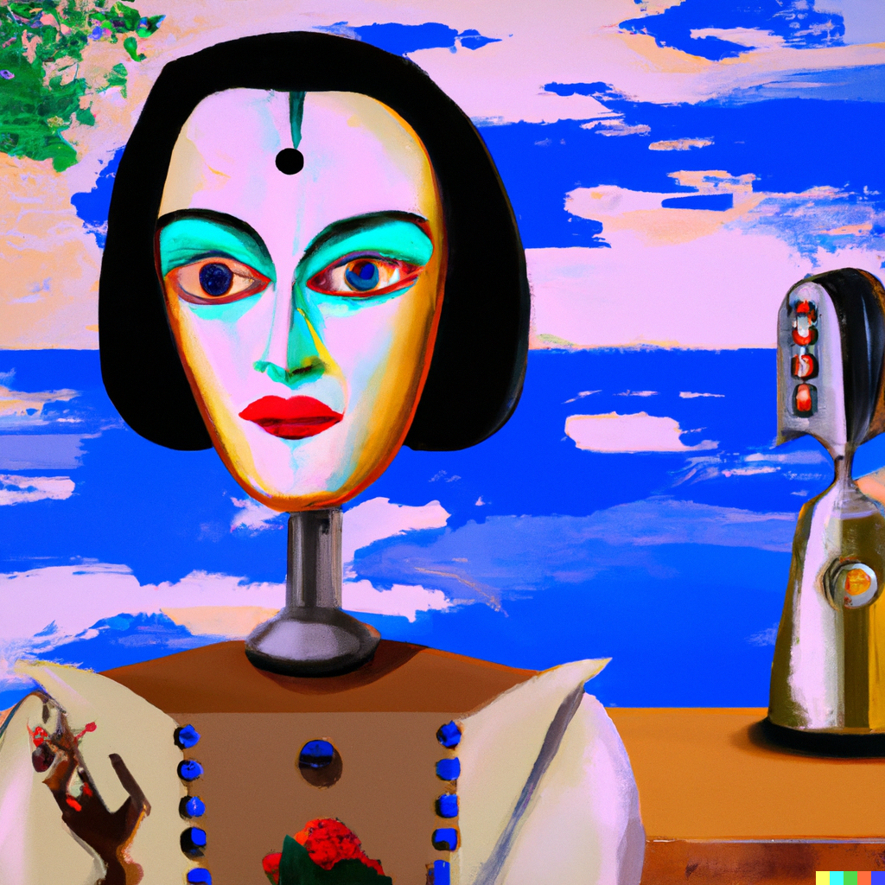
NLI PRESENTATION
DONGJUN TANG, GUILLEN MORENO ARENAS, IGOR KUZMIN
20 MARCH, 2023
1 GitHub Organization
4 Repositories
+10 Branches
+150 Commits
+15 modules on Master
9 Neural Networks Trained
+3000 Lines of Code!

Slide 3


Slide 4
NLI PRESENTATION
DONGJUN TANG, GUILLEN MORENO ARENAS, IGOR KUZMIN
20 MARCH, 2023
PRESENTATION OUTLINE
INTRODUCTION
SYSTEM ARCHITECTURE
PIPELINE STRUCTURE
Intent Classifiers
Non-AI Branch
AI Branch
DEPLOYMENT
DEMONSTRATION
FUTURE WORK

Slide 5


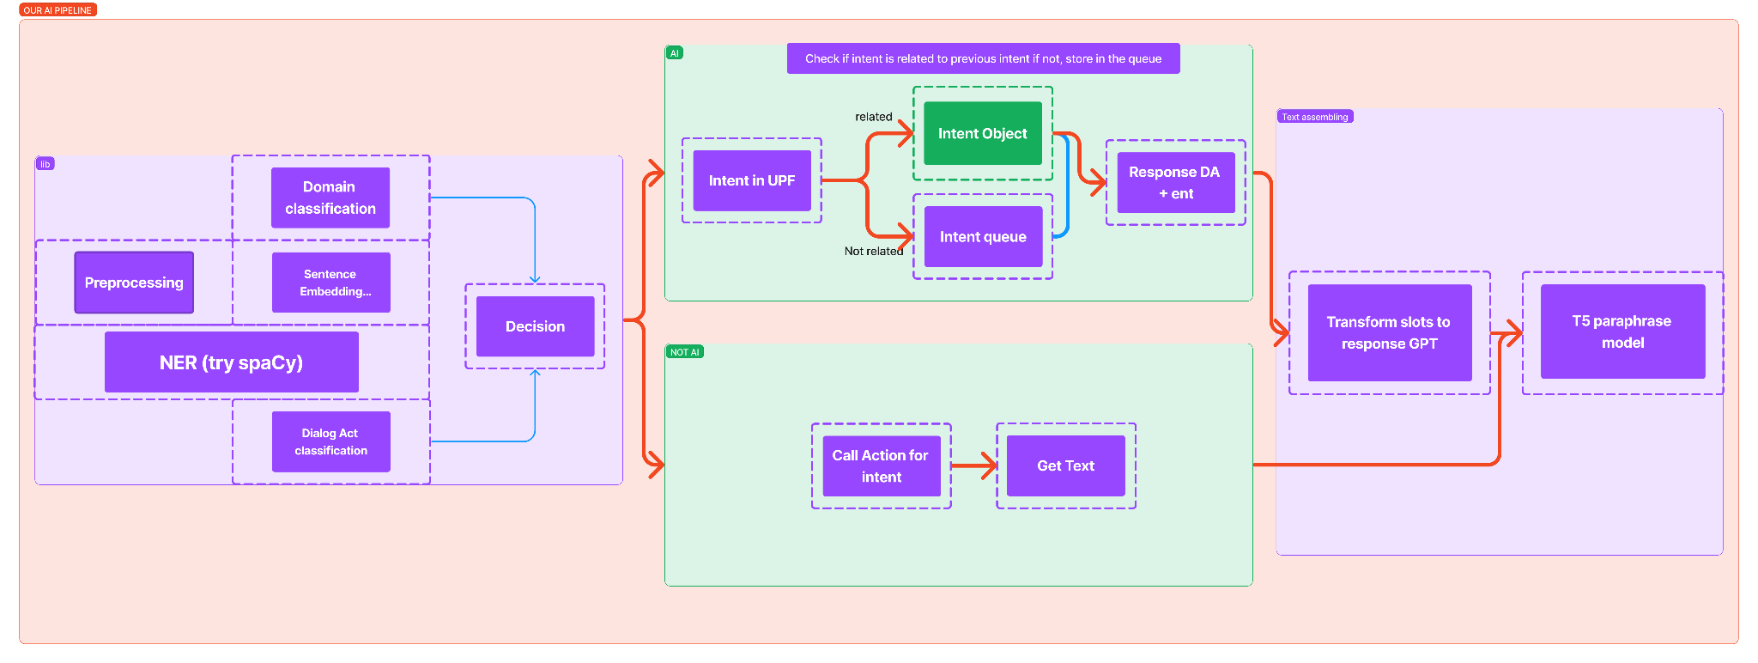
NLI PRESENTATION
DONGJUN TANG, GUILLEN MORENO ARENAS, IGOR KUZMIN
20 MARCH, 2023
INTRODUCTION: Beyond Finite state assistants

Slide 6



NLI PRESENTATION
DONGJUN TANG, GUILLEN MORENO ARENAS, IGOR KUZMIN
20 MARCH, 2023
INTRODUCTION
FLEXIBILITY: Possible to use AI solution for domain conversation and Not AI scripted logic with “actions” (RASA paradigm) for not domain intents.
MEMORY: Model can request information n times in UPF domain.
VARIATIVE GENERATION: SC-GPT and T5 paraphrasing model allow to generate variety of responses with the same keywords.
COMPATIBILITY: Uses RASA configuration file to train NER, create intent objects and slot-filling.
EXPANDABLE FUNCTIONALITY: Possible to retrain models and apply it for different domains, apply extensions.
CONNECTIVITY TO REMOTE SERVERS: Possible to connect the system to other available servers, as we have been able to do with EVA.

Slide 7
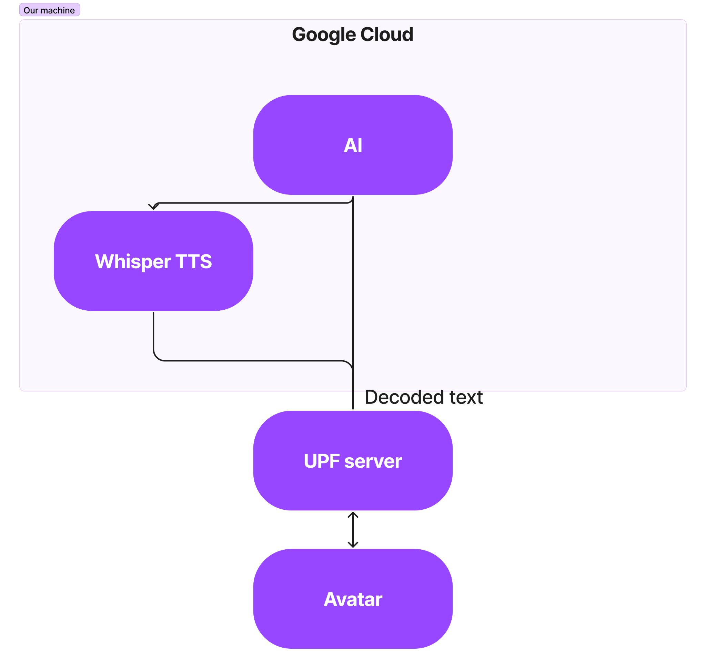


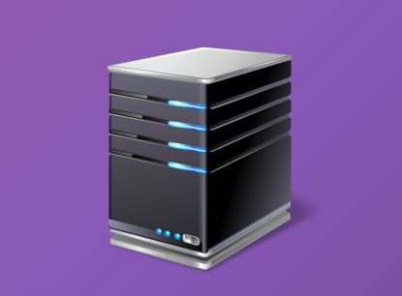
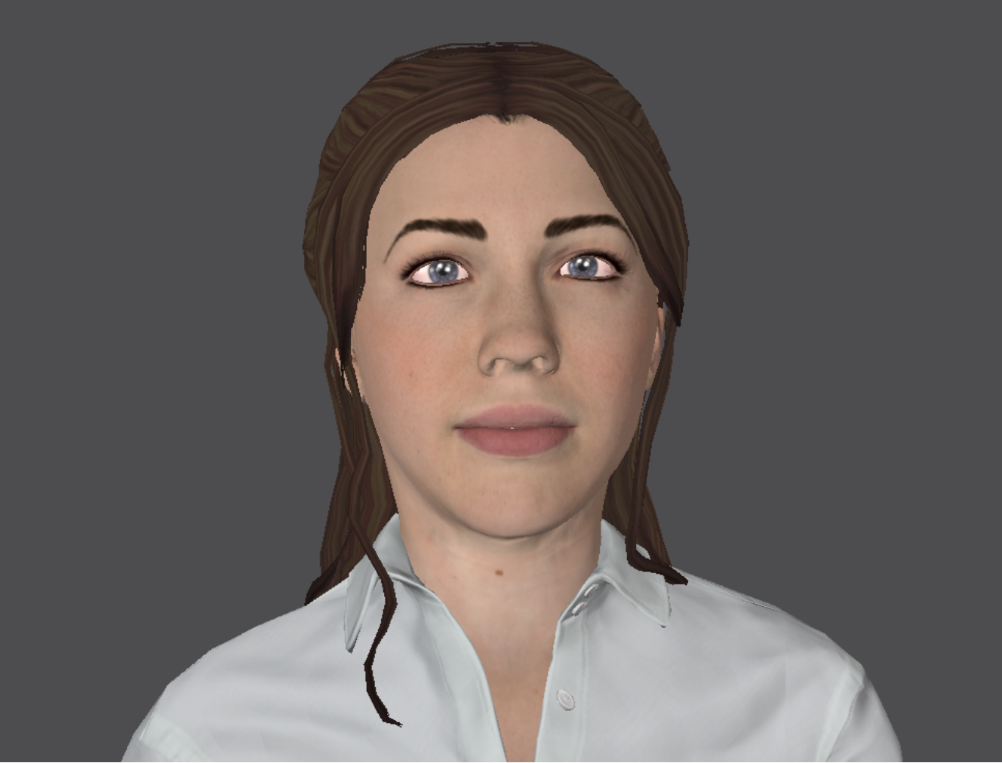
NLI PRESENTATION
DONGJUN TANG, GUILLEN MORENO ARENAS, IGOR KUZMIN
20 MARCH, 2023
2. SYSTEM ARCHITECTURE

Slide 8
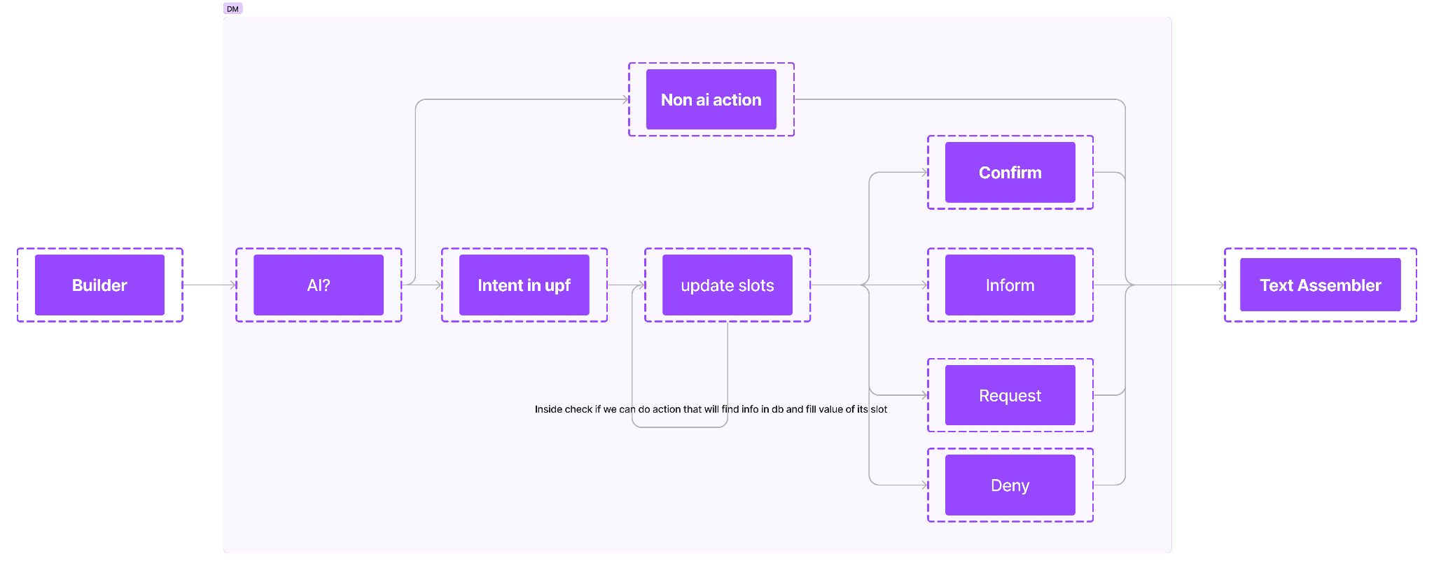
NLI PRESENTATION
DONGJUN TANG, GUILLEN MORENO ARENAS, IGOR KUZMIN
20 MARCH, 2023
3. PIPELINE STRUCTURE

Slide 9
NLI PRESENTATION
DONGJUN TANG, GUILLEN MORENO ARENAS, IGOR KUZMIN
20 MARCH, 2023
Intent Classifiers
UPF / NON-UPF
generic.yml
CLINC150: 150 "in-scope" intent classes, each with 100 train, 20 validation, and 30 test samples. Also 100 train and validation out-of-scope samples.
+
Our own-made dataset with UPF-Related questions (195)
Intents:
150 + 1 (“upf”)
UPF INTENT
nlu.yml
Trained with our own-made dataset (195)
Intents:
Professor
Course
Department
Opening_close_hours
Campus
Schedule
INTENT RELATION FOR USER ANSWERS
Trained with CLINC150+Our own-made dataset (195+130)*
Intents:
Answer related → fill slots…
Answer to another question / New question / Non-UPF related
→ UPF/Non-UPF Classifier

Slide 10
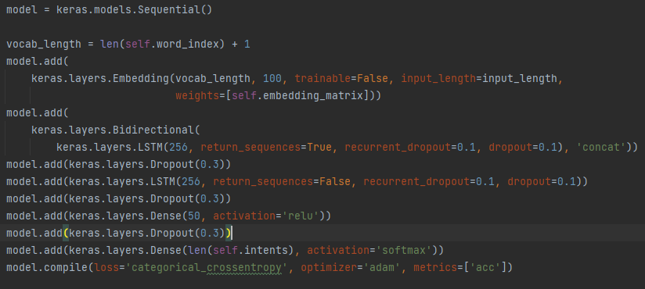
NLI PRESENTATION
DONGJUN TANG, GUILLEN MORENO ARENAS, IGOR KUZMIN
20 MARCH, 2023
Intent Classifiers
Model:
Embedding layer (vocab_length x 100)
LSTM (256 units)
Dropout (p = 0.3)
LSTM (256 units)
Dropout (p = 0.3)
Dense (50 neurons)
Dropout (p = 0.3)
Dense (n_intents → softmax)
Preprocessing.
One-hot encoding
Train-Test split
Tokenizer
Keras Tokenizer
Word Embedding Matrix
GloVe (http GET request)
Text-to-sequences
Keras text-to-sequence

Slide 11
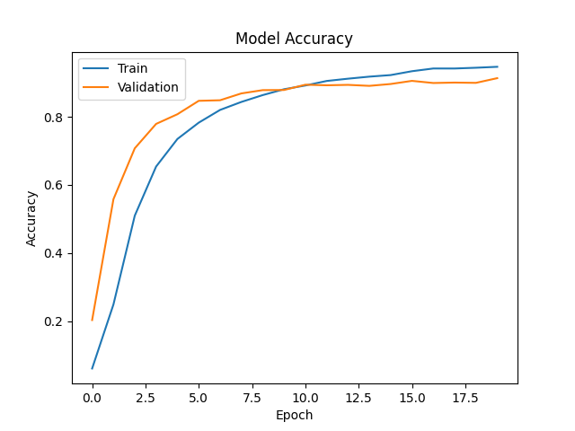
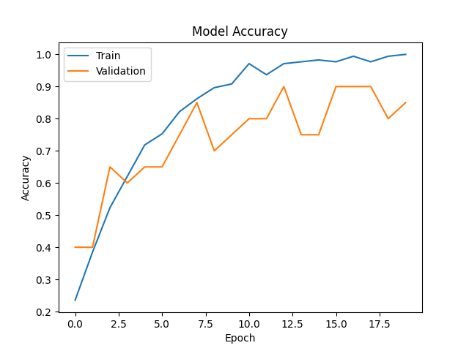
NLI PRESENTATION
DONGJUN TANG, GUILLEN MORENO ARENAS, IGOR KUZMIN
20 MARCH, 2023
Intent Classifiers
- Batch: 107s (312ms/step)
- Loss: 0.1703
- Acc: 0.9529
- Val_loss: 0.4475
- Val_acc: 0.9085
- UPF/Non-UPF Acc: 0.995
- Train time: 35m
- Predict time: 300ms (avg.)
- Batch: 4s (387ms/step)
- Loss: 0.0230
- Acc: 0.9967
- Val_loss: 0.8297
- Val_acc: 0.9000
- Train time: 2m
- Predict time: 300ms (avg.)

Slide 12
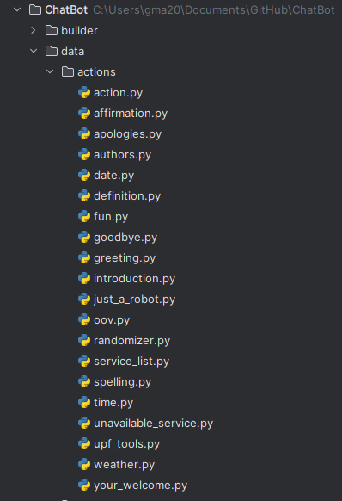
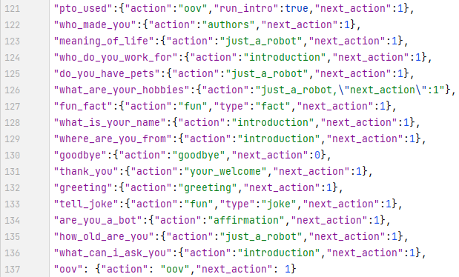
NLI PRESENTATION
DONGJUN TANG, GUILLEN MORENO ARENAS, IGOR KUZMIN
20 MARCH, 2023
b. Non-AI Branch
Intent To Action
Action
(non-AI)
Intent
Action + Params
Text
Non-AI Action DB

Slide 13


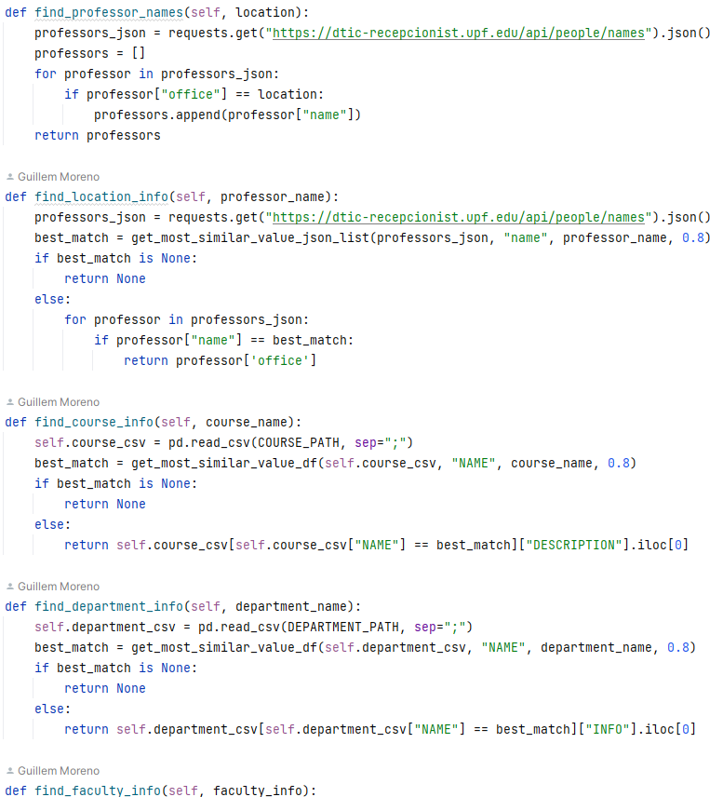
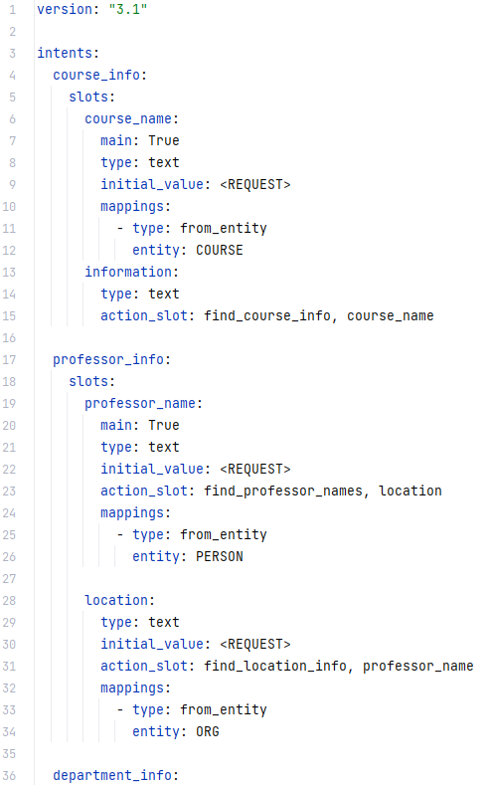
NLI PRESENTATION
DONGJUN TANG, GUILLEN MORENO ARENAS, IGOR KUZMIN
20 MARCH, 2023
c. AI Branch
Slot Filling
Local Knowledge DB
NER
Intent
Intent To Action
Action
Paraphraser
Intent
Action + Params
Text
Text
Entities
AI
Action DB

Slide 14
NLI PRESENTATION
DONGJUN TANG, GUILLEN MORENO ARENAS, IGOR KUZMIN
20 MARCH, 2023
c. AI Branch: NER
Slot Filling
Local Knowledge DB
Intent
NER
Intent
Intent To Action
Action + Params
Action
Text
Paraphraser
Text
Datasets:
NLU.yml in rasa format.
Model:
Blank en model, en_core_web_sm model. Mixed registers (lowercase and title case)
Handle custom entities: COURSE, DEPARTMENT, CAMPUS.
Entities
AI
Action DB

Slide 15
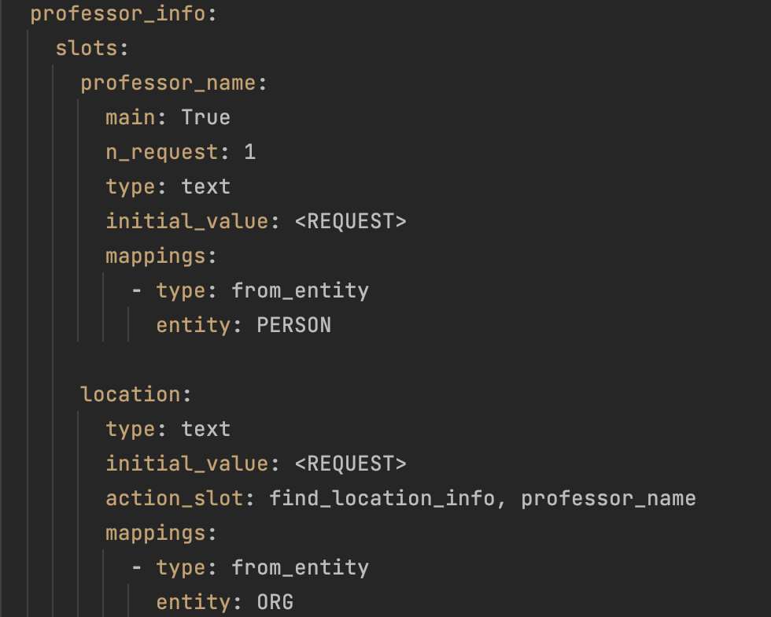
NLI PRESENTATION
DONGJUN TANG, GUILLEN MORENO ARENAS, IGOR KUZMIN
20 MARCH, 2023
c. AI Branch: Slot Filling
Slot Filling
Local Knowledge DB
Intent
NER
Intent
Intent To Action
Action + Params
Action
Text
Paraphraser
Text
Entities
AI
Action DB
Slots:
Each intent can have different number of slots. When we receive information about main slot we can execute action that will fill other slots from database
Slots are filled by matching extracted entities
N_request - number of repetitions of requests

Slide 16

NLI PRESENTATION
DONGJUN TANG, GUILLEN MORENO ARENAS, IGOR KUZMIN
20 MARCH, 2023
c. AI Branch: SC-GPT
Slot Filling
Local Knowledge DB
Intent
NER
Intent
Intent To Action
Action + Params
Action
Text
Paraphraser
Text
Entities
AI
Action DB
Datasets:
Automatically created dataset. Total number of training examples 2620. Number of epochs 5, learning rate = 1e-4, training batch size = 16.
4 Types of responses: inform, request, confirm, deny
Model:
Based on sc-gpt model (fine-tuned gpt2).
AVG Loss = 0.09.
You can find the result model in the igorktech/sc-gpt-upf.

Slide 17
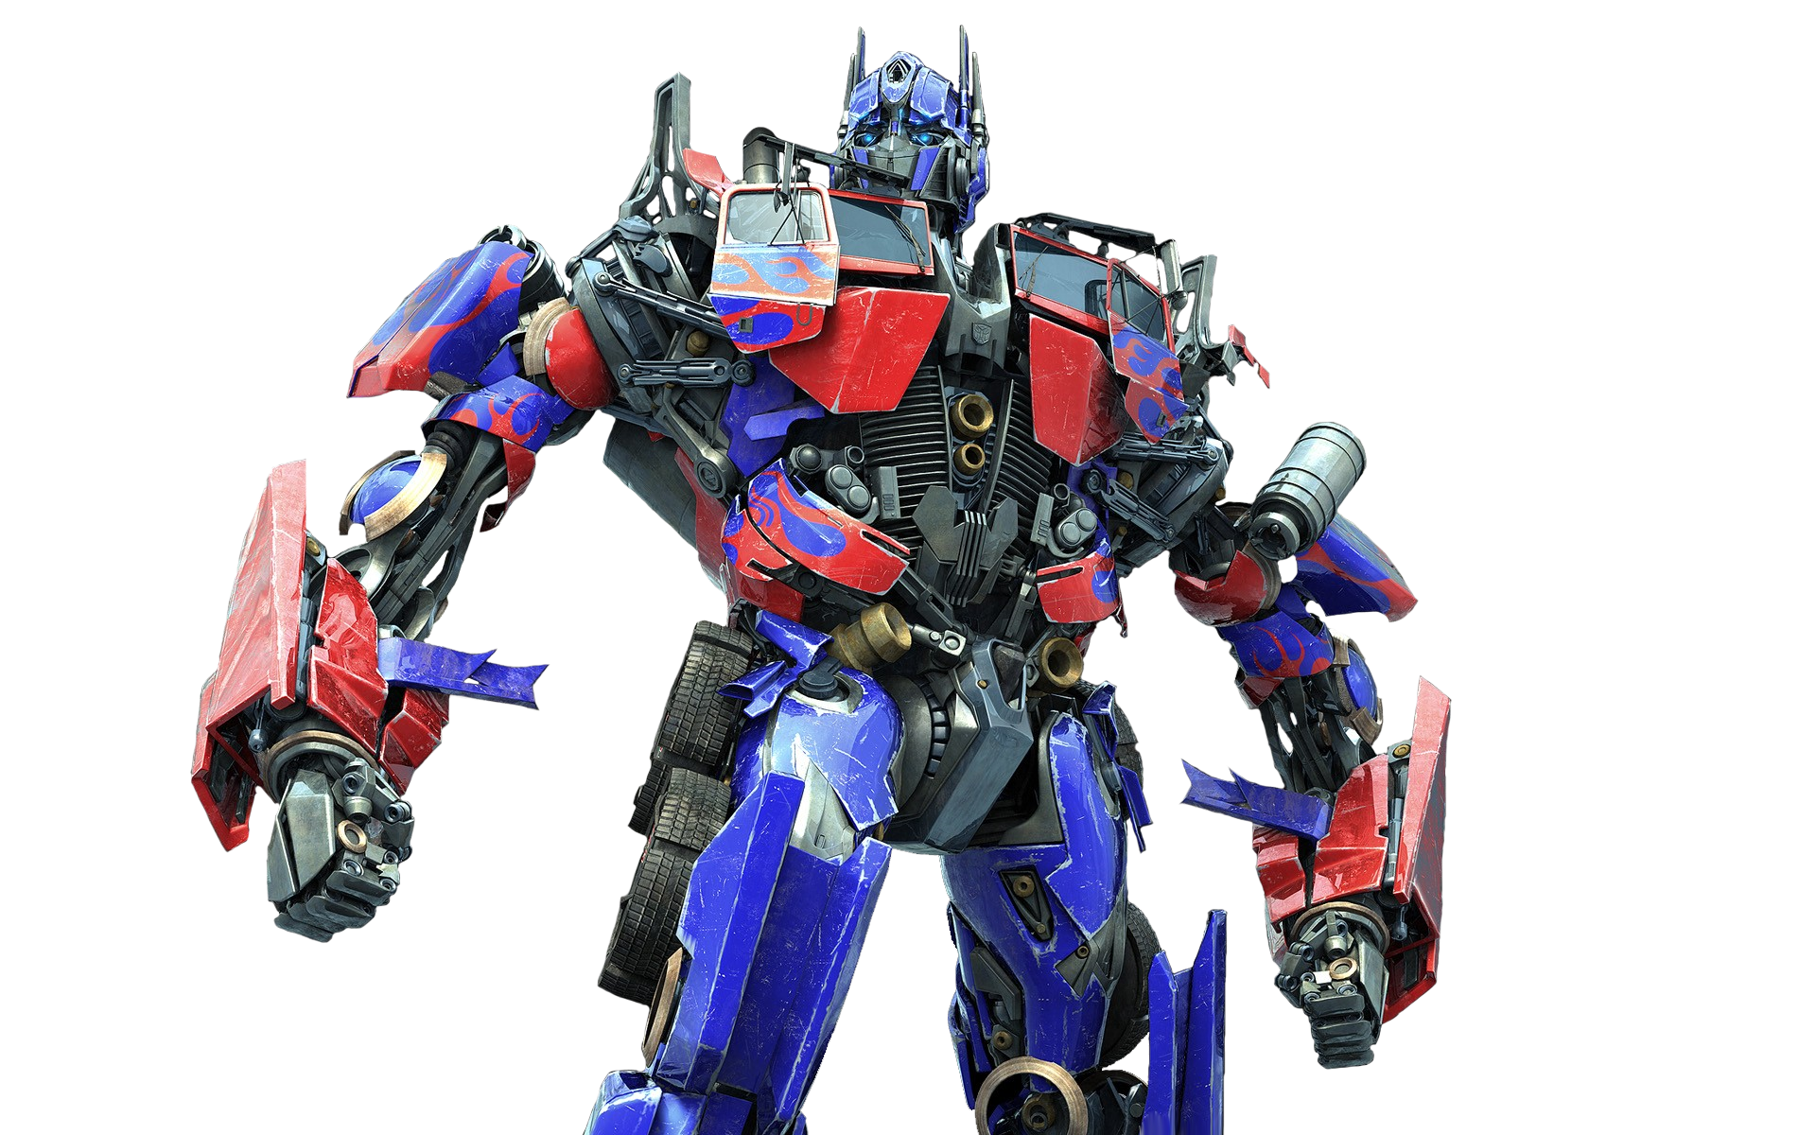
NLI PRESENTATION
DONGJUN TANG, GUILLEN MORENO ARENAS, IGOR KUZMIN
20 MARCH, 2023
c. AI Branch: T5 Paraphraser
Slot Filling
Local Knowledge DB
Intent
NER
Intent
Intent To Action
Action + Params
Action
Text
Paraphraser
Text
Datasets:
Paranmt 5m, msrp, paws, opinosis. For each dataset number of epochs 10, learning rate = 1e-4.
Model:
Based on model huggingface.co/igorktech/t5-base-en with 20k english tokens - 98% of vocabulary contains wide range of tokens for different languages.
AVG BLEU on quora 4k pairs: 38.8
You can find the result models in the igorktech/ent5-base-paraphraser igorktech/ent5-base-paraphraser-detox
Entities
AI
Action DB

Slide 18

NLI PRESENTATION
DONGJUN TANG, GUILLEN MORENO ARENAS, IGOR KUZMIN
20 MARCH, 2023
4. DEPLOYMENT - basic architecture
User
EVA INTERACTION SERVER
DATA PROCESSING SERVER
Audio
Question
Audio
Answer
Transcribe the audio.
Render the user interface.
Answer the question.

Slide 19
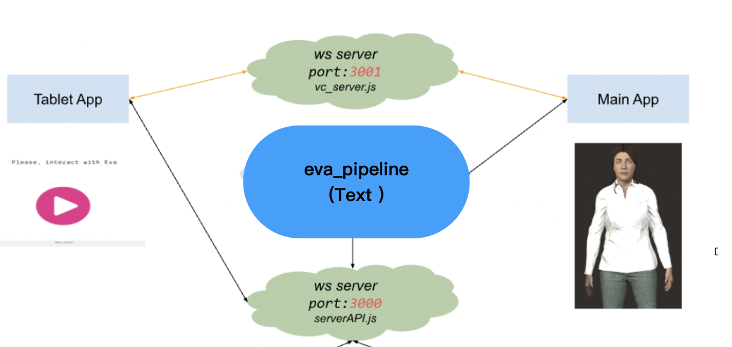
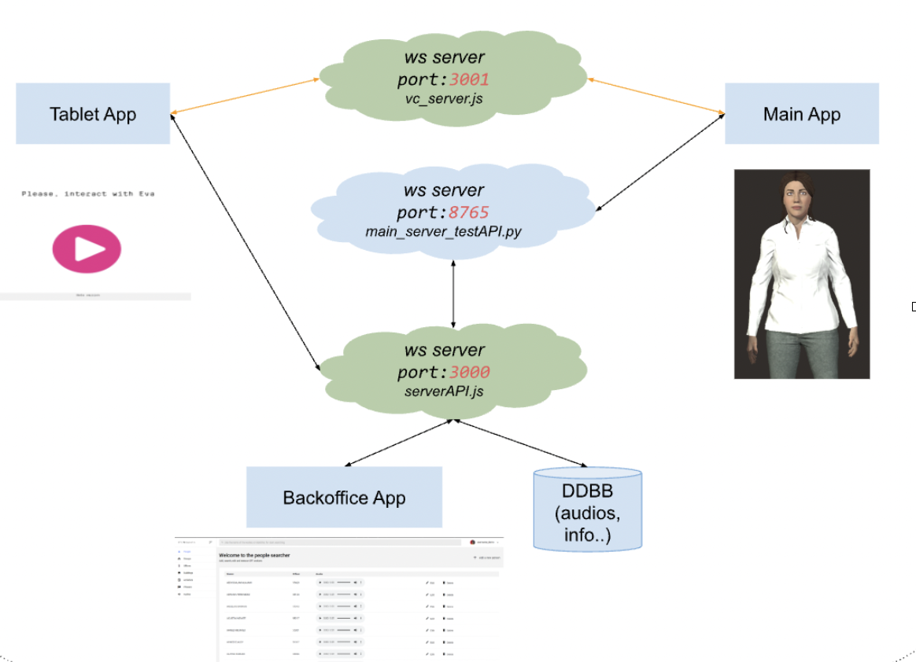
NLI PRESENTATION
DONGJUN TANG, GUILLEN MORENO ARENAS, IGOR KUZMIN
20 MARCH, 2023
4. DEPLOYMENT - EVA server
Original architecture
Our architecture

Slide 20
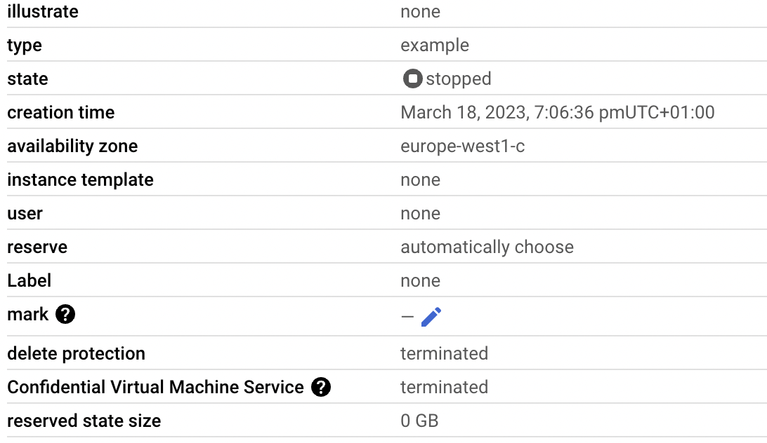
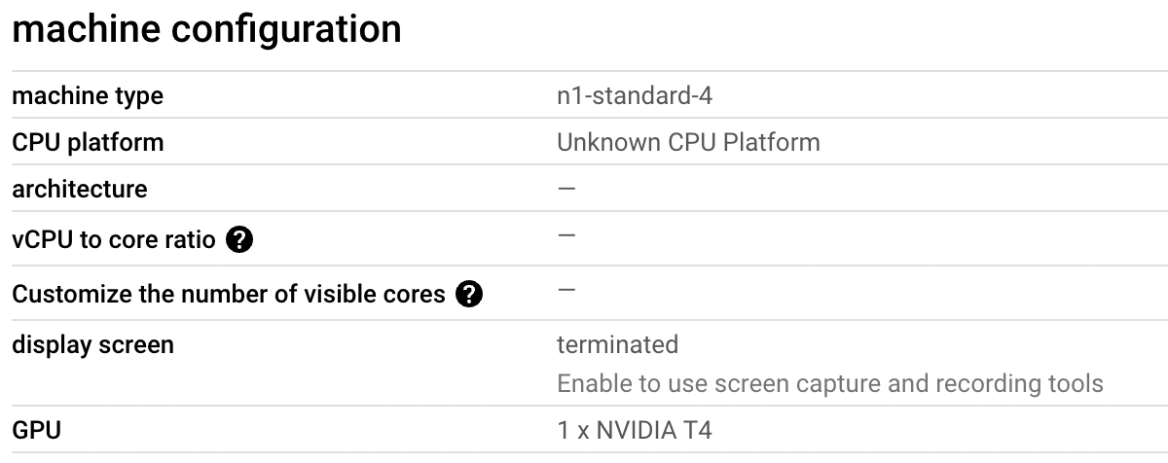
NLI PRESENTATION
DONGJUN TANG, GUILLEN MORENO ARENAS, IGOR KUZMIN
20 MARCH, 2023
4. DEPLOYMENT - data processing server

Slide 21

NLI PRESENTATION
DONGJUN TANG, GUILLEN MORENO ARENAS, IGOR KUZMIN
20 MARCH, 2023
5. DEMONSTRATION
3D model resource
from
UPF EVA Developing Group

Slide 22
NLI PRESENTATION
DONGJUN TANG, GUILLEN MORENO ARENAS, IGOR KUZMIN
20 MARCH, 2023
6. FUTURE WORK
PIPELINE:
Improve Eva’s ASR.
Neural networks optimization.
Improve Dialog Manager.
Improve generation with triplets.
Documentation.

Slide 23
NLI PRESENTATION
DONGJUN TANG, GUILLEN MORENO ARENAS, IGOR KUZMIN
20 MARCH, 2023
THANK YOU!

Slide 24
NLI PRESENTATION
DONGJUN TANG, GUILLEN MORENO ARENAS, IGOR KUZMIN
20 FEBRUARY, 2023
4. OUR PIPELINE: ASSISTANT ARCHITECTURE

Slide 25
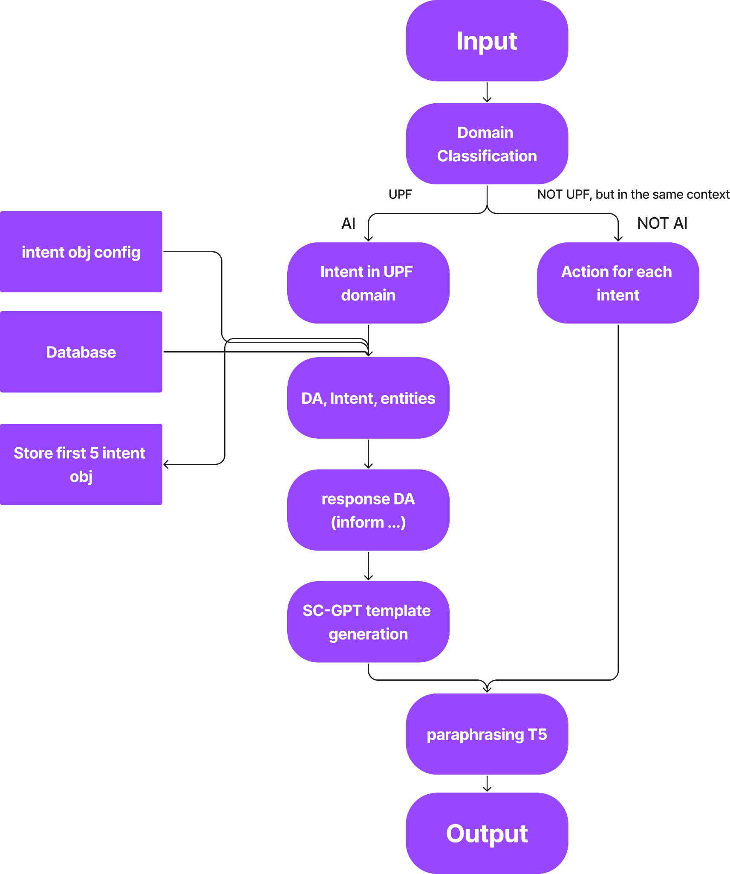
NLI PRESENTATION
DONGJUN TANG, GUILLEN MORENO ARENAS, IGOR KUZMIN
20 FEBRUARY, 2023
ASSISTANT LOGIC DIAGRAM

Slide 26
NLI PRESENTATION
DONGJUN TANG, GUILLEN MORENO ARENAS, IGOR KUZMIN
20 FEBRUARY, 2023
4. OUR PIPELINE: ADVANTAGES
FLEXIBILITY: Possible to use AI solution for domain conversation and Not AI scripted logic with “actions” (RASA paradigm) for not domain intents.
MEMORY: Will keep 5 latest intents in UPF domain.
VARIATIVE GENERATION: SC-GPT and T5 paraphrasing model allow to generate variety of responses with the same keywords.
COMPATIBILITY: Uses RASA configuration file to train NER, create intent objects and slot-filling.
EXPANDABLE FUNCTIONALITY: Possible to retrain models and apply it for different domains, apply extensions.

Slide 27
NLI PRESENTATION
DONGJUN TANG, GUILLEN MORENO ARENAS, IGOR KUZMIN
20 FEBRUARY, 2023
5. NEURAL NETWORKS: DOMAIN CLASSIFICATION
UPF / NON-UPF
CLINC150: 150 "in-scope" intent classes, each with 100 train, 20 validation, and 30 test samples. Also 100 train and validation out-of-scope samples.
+
Our own-made dataset with UPF-Related questions (195)
Intents:
150 + 1 (“upf”)
UPF INTENT
Trained with our own-made dataset (195)
Intents:
Professor
Course
Department
Opening_hours
Faculty_location
Schedule
INTENT RELATION FOR USER ANSWERS
Trained with CLINC150+Our own-made dataset (195+130)*
Intents:
Answer related → fill slots…
Answer to another question / New question / Non-UPF related
→ UPF/Non-UPF Classifier

Slide 28
NLI PRESENTATION
DONGJUN TANG, GUILLEN MORENO ARENAS, IGOR KUZMIN
20 FEBRUARY, 2023
5. NEURAL NETWORKS: DOMAIN CLASSIFICATION
Model:
Embedding layer (vocab_length x 100)
LSTM (256 units)
Dropout (p = 0.3)
LSTM (256 units)
Dropout (p = 0.3)
Dense (50 neurons)
Dropout (p = 0.3)
Dense (n_intents → softmax)
Preprocessing.
One-hot encoding
Train-Test split
Tokenizer
Keras Tokenizer
Word Embedding Matrix
GloVe
Text-to-sequences
Keras text-to-sequence

Slide 29
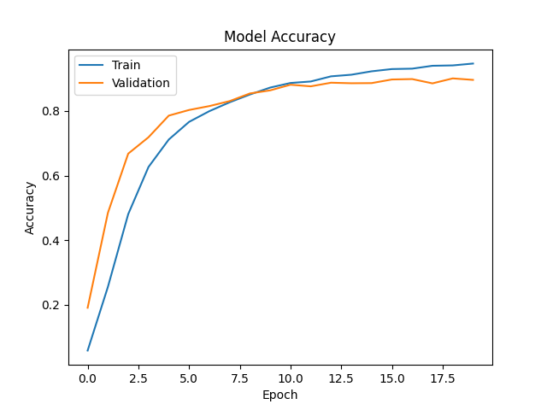
NLI PRESENTATION
DONGJUN TANG, GUILLEN MORENO ARENAS, IGOR KUZMIN
20 FEBRUARY, 2023
5. NEURAL NETWORKS: DOMAIN CLASSIFICATION
Val_acc: 90.7%
Errors:
'John.', 'make_call',’Professor’
'Dr. Jones.', 'make_call',’Professor’
"I'm looking for information about the psychology course that's taught by Professor Johnson. Do you know anything about it?", '1', '2'
'Looking for syllabus for econ course', 'oos','2’
"I'm looking for the closing time of the financial aid office on Wednesdays.", '3'
…
- Batch: 107s (312ms/step)
- Loss: 0.1703
- Acc: 0.9529
- Val_loss: 0.4475
- Val_acc: 0.9085
- UPF/Non-UPF Acc: 0.995
- Train time: 35m
- Predict time: 300ms (avg.)
- Batch: 4s (387ms/step)
- Loss: 0.0230
- Acc: 0.9967
- Val_loss: 0.8297
- Val_acc: 0.9000
- Train time: 2m
- Predict time: 300ms (avg.)

Slide 30
NLI PRESENTATION
DONGJUN TANG, GUILLEN MORENO ARENAS, IGOR KUZMIN
20 FEBRUARY, 2023
5. NEURAL NETWORKS: DA CLASSIFICATION
Datasets:
DA (dialog act) - spoken utterances classification according to its category of meaning.
Utterance are tagged with the MRDA tagset, which is a variation of the SWBD-DAMSL
Total number of general classes: 12.
Model architecture:
Bert based model with MLP as output [1].
Tested 3 models: bert-base-uncased, and TinyBERT with 4 and 6 layers and 312 and 768 dim.
Dialogue Act | Labels | Count | %
Statement | s | 69873 | 64.58
Continuer | b | 15167 | 14.02
Floor Holder | fh | 8362 | 7.73
Yes-No-question | qy | 4986 | 4.61
Interrupted/Abandoned/Uninterpretable | % | 3103 | 2.87
Floor Grabber | fg | 3092 | 2.86
Wh-Question | qw | 1707 | 1.58
Hold Before Answer/Agreement | h | 792 | 0.73
Or-Clause | qrr | 392 | 0.36
Rhetorical Question | qh | 352 | 0.33
Or Question | qr | 207 | 0.19
Open-ended Question | qo | 169 | 0.16

Slide 31
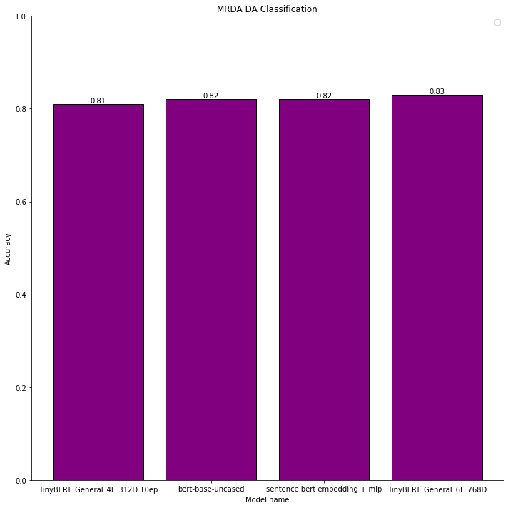
NLI PRESENTATION
DONGJUN TANG, GUILLEN MORENO ARENAS, IGOR KUZMIN
20 FEBRUARY, 2023
5. NEURAL NETWORKS: DA CLASSIFICATION
Results:
All models show accuracy higher than 80%.
The best Performance that has been ever achieved in researches is approximately 90%.
Limitations:
This dataset is not suitable for specific tasks.
The resulting models are inferior in speed compare to LSTM and classic ML models.
Long learning time (TinyBert 4L - 0.5h, TinyBert 6L - 2,5h, Bert-base-uncased - 6h).
If we use model, that contains bert layer, production is 10 slower than sentence bert embedding + mlp layer.

Slide 32
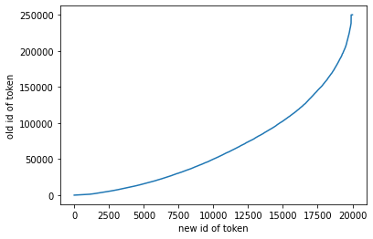
NLI PRESENTATION
DONGJUN TANG, GUILLEN MORENO ARENAS, IGOR KUZMIN
20 FEBRUARY, 2023
5. NEURAL NETWORKS: T5 transformer
Dataset:
English language Leipzig corpora with 1M of sentences.
Model:
Google mt5-base [3] model contains wide range of tokens for different languages.
English vocabulary: 10k tokens - 95% of vocabulary, 20k - 98%, 30k-99%.
The plot shows the most frequent tokens in the base vocabulary appear more frequently in the new vocabulary. New vocabulary contains 20k tokens.
You can find the result model in the huggingface.co/igorktech/t5-base-en
Limitations:
This model is possible to use with latin alphabet and only for english language.

Slide 33
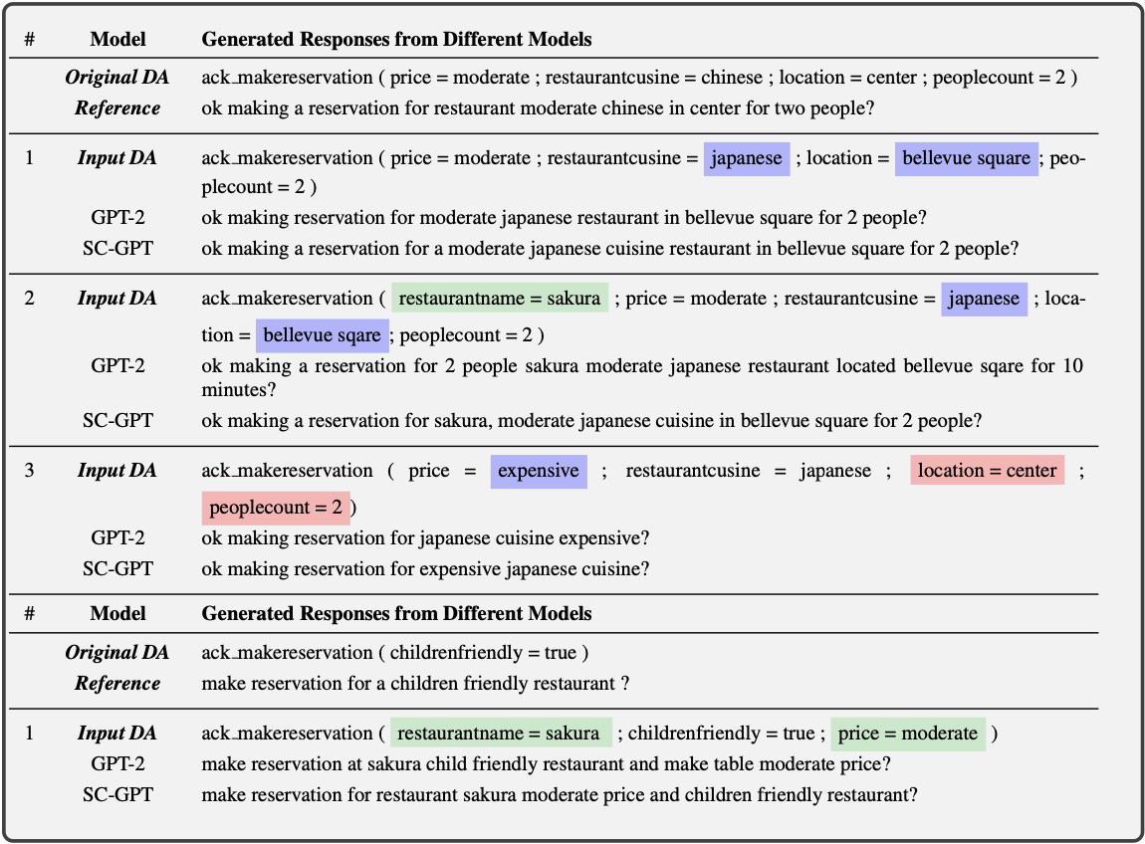
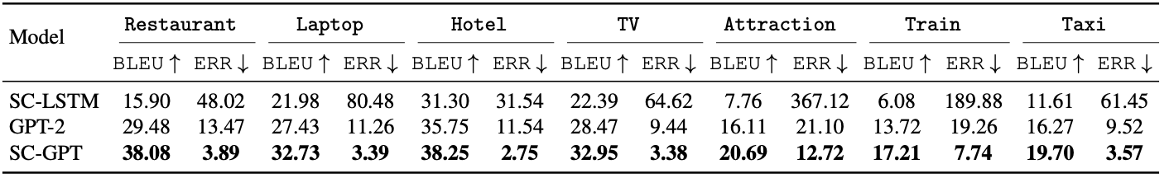
NLI PRESENTATION
DONGJUN TANG, GUILLEN MORENO ARENAS, IGOR KUZMIN
20 FEBRUARY, 2023
5. NEURAL NETWORKS: SC-GPT
Model:
Semantically conditioned model for task-oriented dialog systems [4].
Has best overall performance in both automatic and human evaluations than SC-LSTM GPT-2 on FewShotWOZ dataset.
Open source model and architecture.
Metrics:
BLEU - evaluates how natural the generated text is compared with human readers.
ERR - matching of the slot tokens in the candidate utterances.

Slide 34
NLI PRESENTATION
DONGJUN TANG, GUILLEN MORENO ARENAS, IGOR KUZMIN
20 FEBRUARY, 2023
6. FUTURE WORK
RASA PIPELINE:
Add additional extentional functionality.
Connect ASR and TTS.
OUR PIPELINE:
Train/test T5 model for paraphrasing task on open datasets.
Train/test SC-GPT model for template generation.
Add actions functionality.
Response assembling mechanism.
Add additional extentional functionality.
Connect ASR and TTS.
Use asynchronism and optimize to decrease processing time.

Slide 35
NLI PRESENTATION
DONGJUN TANG, GUILLEN MORENO ARENAS, IGOR KUZMIN
20 FEBRUARY, 2023
REFERENCES
[1] Het Pandya, Intent Classifier (2020), GitHub Repository,
https://github.com/hetpandya/intent-classifier
[2] Emile Chapuis, Pierre Colombo, Matteo Manica, Matthieu Labeau, Chloe Clavel. Hierarchical Pre-training for Sequence Labelling in Spoken Dialog (2021). URL https://arxiv.org/abs/2009.11152
[3] Linting Xue, Noah Constant, Adam Roberts, Mihir Kale, Rami Al-Rfou, Aditya Siddhant, Aditya Barua, Colin Raffel. mT5: A massively multilingual pre-trained text-to-text transformer. URL https://arxiv.org/abs/2010.11934
[4] Baolin Peng, Chenguang Zhu, Chunyuan Li, Xiujun Li, Jinchao Li, Michael Zeng, Jianfeng Gao. Few-shot Natural Language Generation for Task-Oriented Dialog (2020). URL https://arxiv.org/abs/2002.12328v1.

Slide 36
NLI PRESENTATION
DONGJUN TANG, GUILLEN MORENO ARENAS, IGOR KUZMIN
20 FEBRUARY, 2023
THANK YOU!

